Slide 1
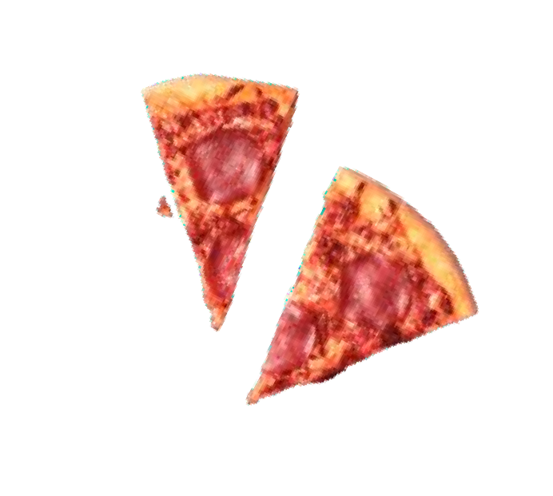
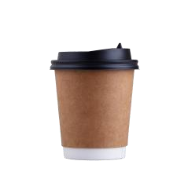
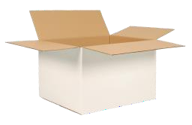
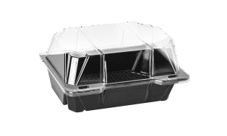
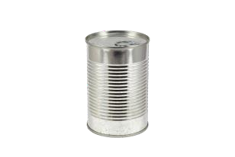
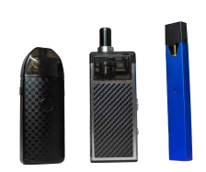
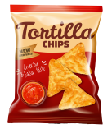
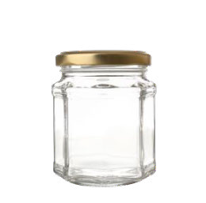
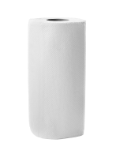
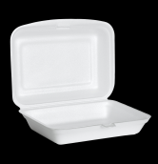
MIXED
RECYCLING
Let’s recycle as much as possible!
Does your waste belong in here?
Yes please to
No thanks to
Paper and
cardboard
Plastic bottles
Food waste
Coffee cups and liquid
Plastic pots,
tubs and trays
Food and
drink cans
Vapes
Plastic film, including crisp packets
Glass bottles and jars
Paper towels
and tissues
Polystyrene containers and packaging
Cartons

Slide 2
MIXED
RECYCLING
Let’s recycle as much as possible!
Does your waste belong in here?
Yes please to
No thanks to
Paper and
cardboard
Plastic bottles
Food waste
Liquids
Plastic pots,
tubs and trays
Food and
drink cans
Vapes
Plastic film, including crisp packets
Cartons and coffee cups
Glass bottles and jars
Paper towels
and tissues
Polystyrene containers and packaging

Slide 3
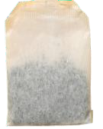
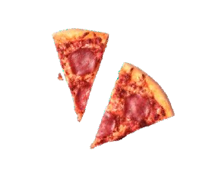
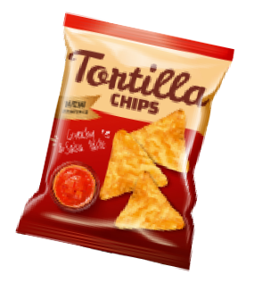
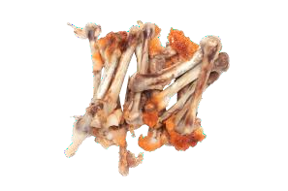
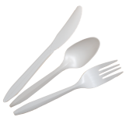
FOOD WASTE
Let’s recycle as much as possible!
Does your waste belong in here?
Yes please to
No thanks to
Tea bags
Coffee grounds
Coffee cups
Liquids
Fruit and
veg peelings
Leftovers
Plastic film
Paper towels
and tissues
Inedible food
Packaging of any kind
Single use cutlery
and plates

Slide 4
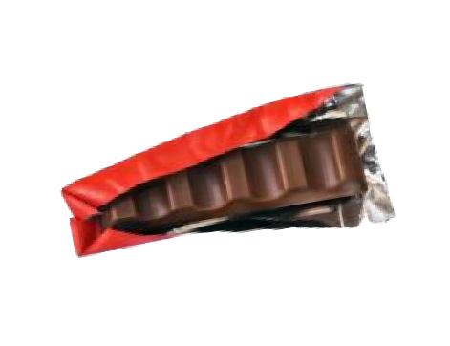
GENERAL WASTE
Let’s recycle as much as possible!
Does your waste belong in here?
Yes please to
No thanks to
Coffee cups
Polystyrene containers and packaging
Paper
Cardboard
Crisp packets
Paper towels
and tissues
Food and
drink cans
Plastic bottles
Sweet wrappers
Single use cutlery and plates
Plastic pots,
tubs and trays
Food waste

Slide 5
GENERAL WASTE
Let’s recycle as much as possible!
Does your waste belong in here?
Yes please to
No thanks to
Polystyrene containers and packaging
Paper towels
and tissues
Paper and
cardboard
Coffee cups
Crisp packets
Single use cutlery
and plates
Food and
drink cans
Plastic bottles
Sweet wrappers
Plastic pots,
tubs and trays
Food waste

Slide 6
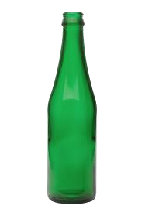
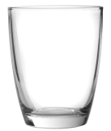
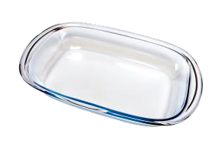
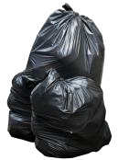
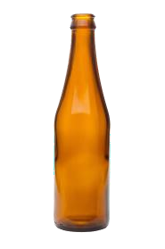
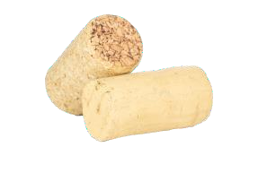
GLASS
Let’s recycle as much as possible!
Does your waste belong in here?
Yes please to
No thanks to
Drinking glasses
Paper and cardboard
Glass jars
Green glass
bottles
Pyrex
Black bags
Clear glass
bottles
Brown glass
bottles
Plastic bottles
Corks

Slide 7
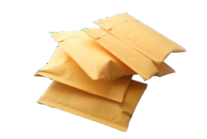
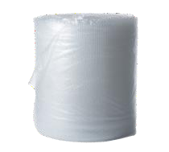
PAPER / CARD
Let’s recycle as much as possible!
Does your waste belong in here?
Yes please to
No thanks to
Paper towels
Jiffy bags
Office paper
Newspapers &
magazines
Food waste
Coffee cups
Envelopes
Cardboard
Bubble wrap
Glass bottles
and jars

Slide 8
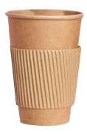
PAPER / CARD
Let’s recycle as much as possible!
Does your waste belong in here?
Yes please to
No thanks to
Office paper
Newspapers &
magazines
Paper towels
Jiffy bags
Envelopes
Cardboard
Food waste
Glass bottles
and jars
Coffee cups
Bubble wrap

Slide 9
Mixed
RECYCLING
Let’s recycle as much as possible!
Does your waste belong in here?
Yes please to
No thanks to
Paper and cardboard
Plastic bottles
Food waste
Coffee cups
and liquid
Plastic pots,
tubs and trays
Food and
drink cans
Vapes
Plastic film, including crisp packets
Cartons
Glass bottles
and jars
Paper towels
and tissues
Polystyrene containers and packaging
Logo Goes here

Slide 10
Mixed
RECYCLING
Let’s recycle as much as possible!
Does your waste belong in here?
Yes please to
No thanks to
Paper and cardboard
Plastic bottles
Food waste
Liquids
Plastic pots,
tubs and trays
Food and
drink cans
Vapes
Plastic film, including crisp packets
Cartons and
coffee cups
Glass bottles
and jars
Paper towels
and tissues
Polystyrene containers and packaging
Logo Goes here

Slide 11
Food
WASTE
Help us stop feeding climate change
Food waste alone generates 8-10% of global greenhouse gas emissions*
Yes please to
No thanks to
Tea bags
Coffee grounds
Coffee cups
Liquids
Fruit and
veg peelings
Leftovers
Plastic film
Paper towels and tissues
Inedible food
Packaging of
any kind
Single use cutlery
and plates
Logo Goes here
*United Nations Environment Programme (2021) Food Waste Index Report 2021 and FAO (2011) Global
Food Losses and Food Waste. Extent, Causes and Prevention.

Slide 12
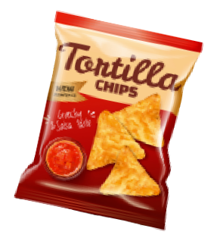
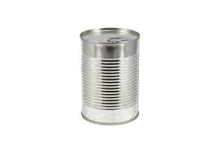
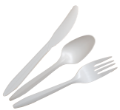
General
WASTE
Let’s recycle as much as possible!
Does your waste belong in here?
Yes please to
No thanks to
Coffee cups
Polystyrene containers and packaging
Paper
Cardboard
Crisp packets
Paper towels
and tissues
Food and
drink cans
Plastic bottles
Sweet wrappers
Single use cutlery and plates
Plastic pots,
tubs and trays
Food waste
Logo Goes here

Slide 13
General
WASTE
Let’s recycle as much as possible!
Does your waste belong in here?
Yes please to
No thanks to
Polystyrene containers and packaging
Paper towels
and tissues
Paper and cardboard
Coffee cups
Crisp packets
Single use cutlery
and plates
Food and
drink cans
Plastic bottles
Sweet wrappers
Plastic pots,
tubs and trays
Food waste
Logo Goes here

Slide 14
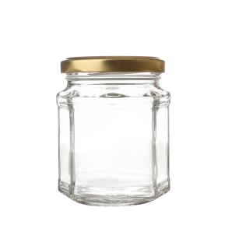
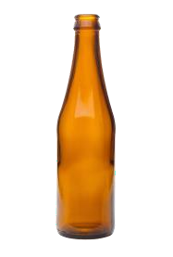
Glass
RECYCLING
Let’s recycle as much as possible!
Does your waste belong in here?
Yes please to
No thanks to
Drinking glasses
Paper and
cardboard
Glass jars
Green glass
bottles
Pyrex
Black bags
Clear glass bottles
Brown glass bottles
Plastic bottles
Corks
Logo Goes here

Slide 15
Paper / card
RECYCLING
Let’s recycle as much as possible!
Does your waste belong in here?
Yes please to
No thanks to
Paper towels
Jiffy bags
Office paper
Newspapers &
magazines
Food waste
Coffee cups
Envelopes
Cardboard
Bubble wrap
Glass bottles and jars
Logo Goes here

Slide 16
Paper / card
RECYCLING
Let’s recycle as much as possible!
Does your waste belong in here?
Yes please to
No thanks to
Office paper
Newspapers &
magazines
Paper towels
Jiffy bags
Envelopes
Cardboard
Food waste
Glass bottles
and jars
Coffee cups
Bubble wrap
Logo Goes here

